Slide 1
Zabel’s agra hadik
celebrating Zabel and welcoming 2021

Slide 2
Welcome!
Notes:
Hi everyone! Do you know each other? Can you indulge us and do some quick introductions?

Slide 3
Click the ^ up arrow next to the “stop video” icon at the bottom left of your screen
Click on “Choose Virtual Background” or “Choose Virtual Filter”
Select a background and/or filter
Enjoy
Virtual backgrounds & filters encouraged!

Slide 4
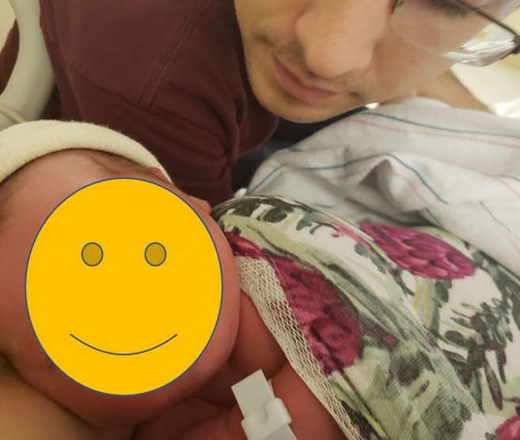
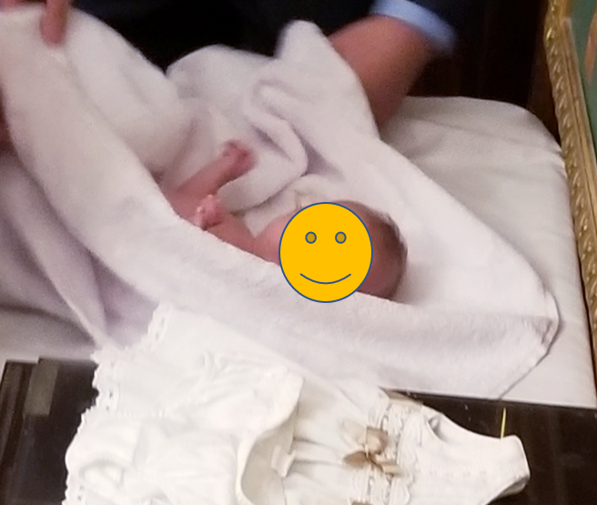
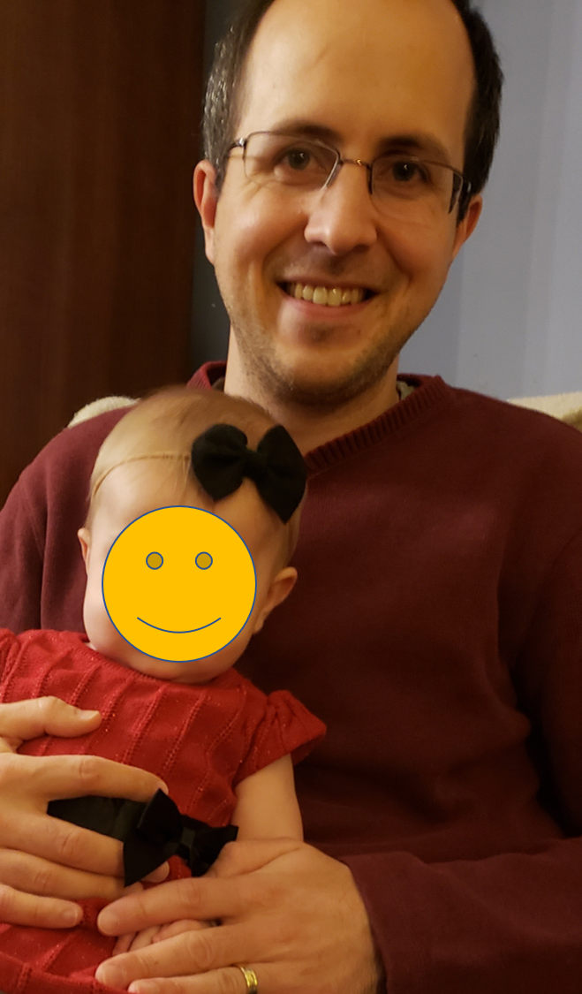
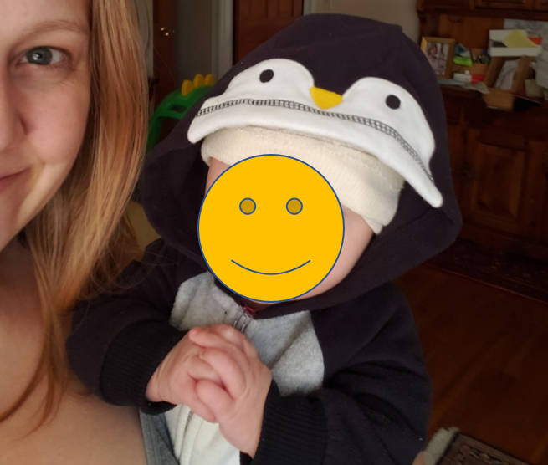
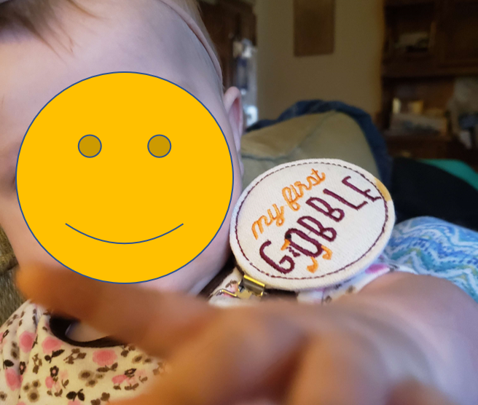
Notes:
2020 Succckkkked…! But we have a few highlights. Zabel was born! Baptism, Halloween, Thanksgiving, Christmas

Slide 5
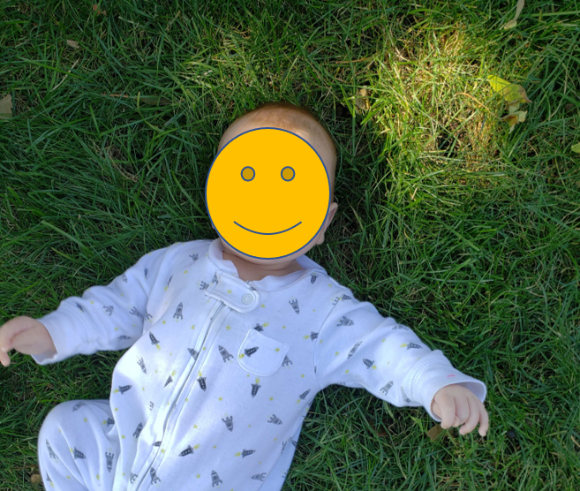
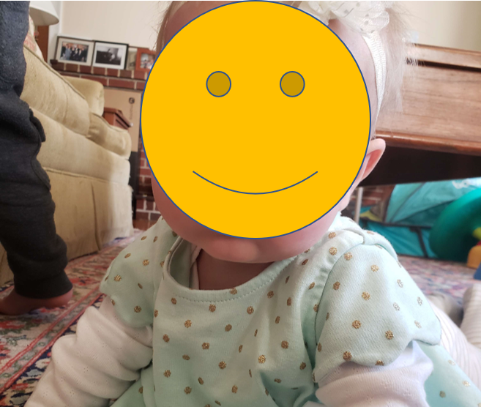
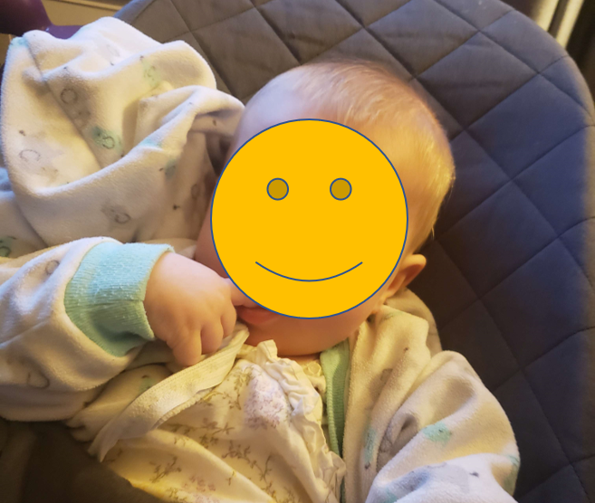
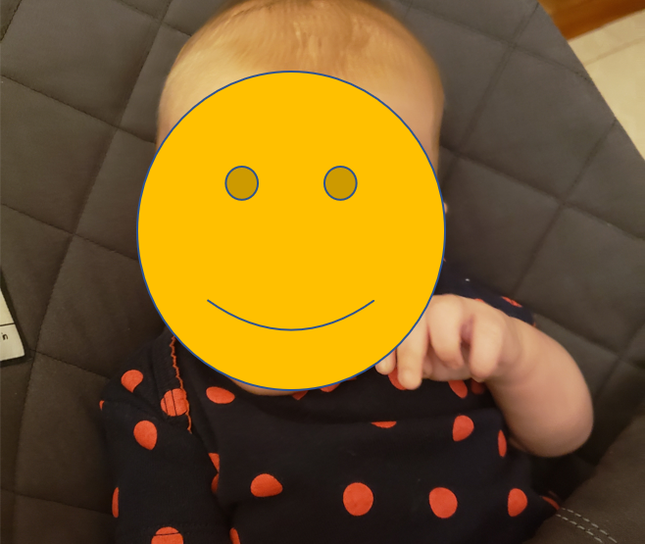
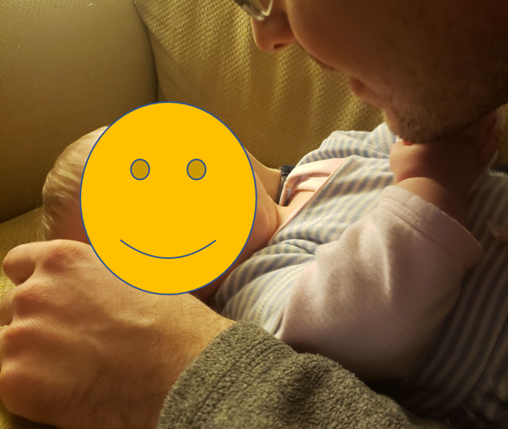
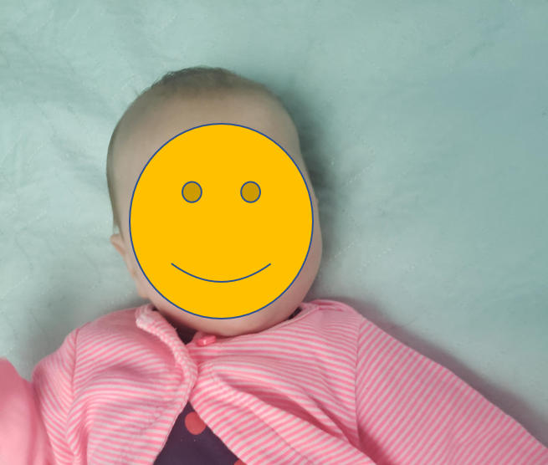
Notes:
Some other favorite photos, while we’re at it.

Slide 6
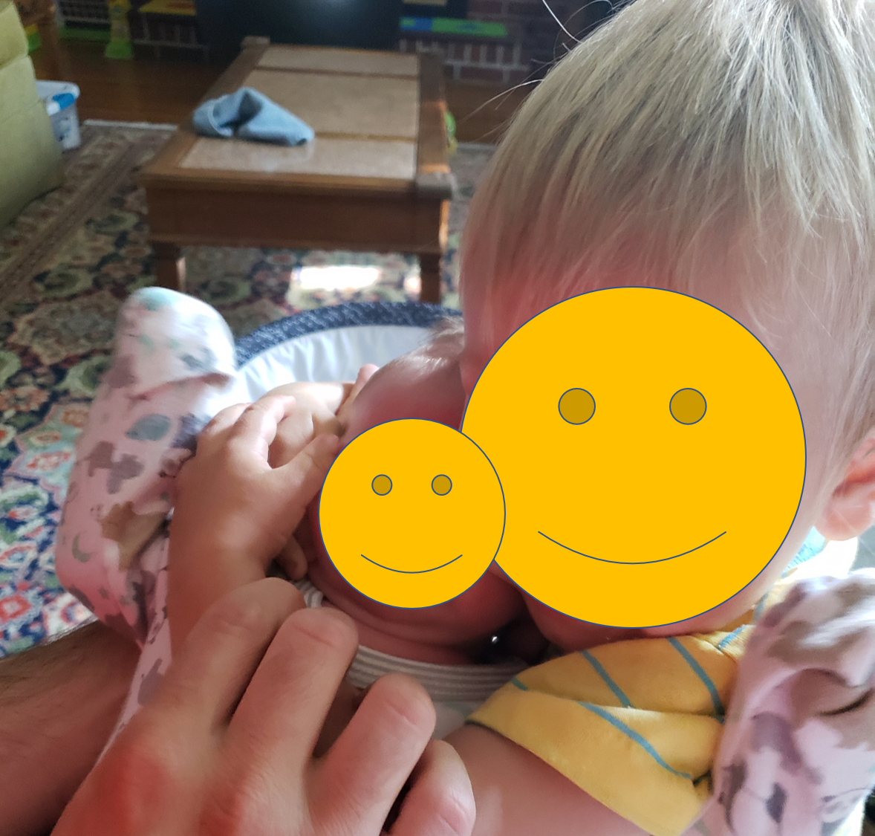
They meet!
Notes:
And then of course, one of the greatest things has been watching our children get to know each other. This is the morning after Zabel came home from the hospital, she’s all of 3 days old in this picture.

Slide 7
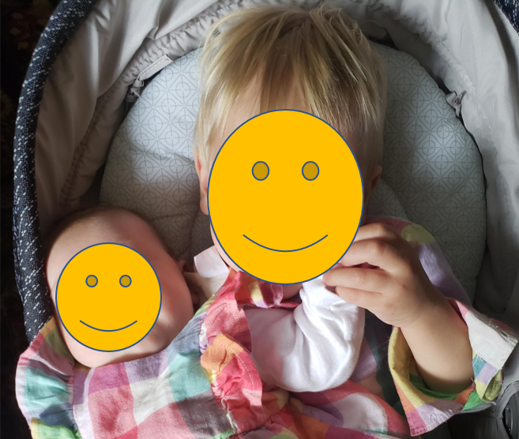
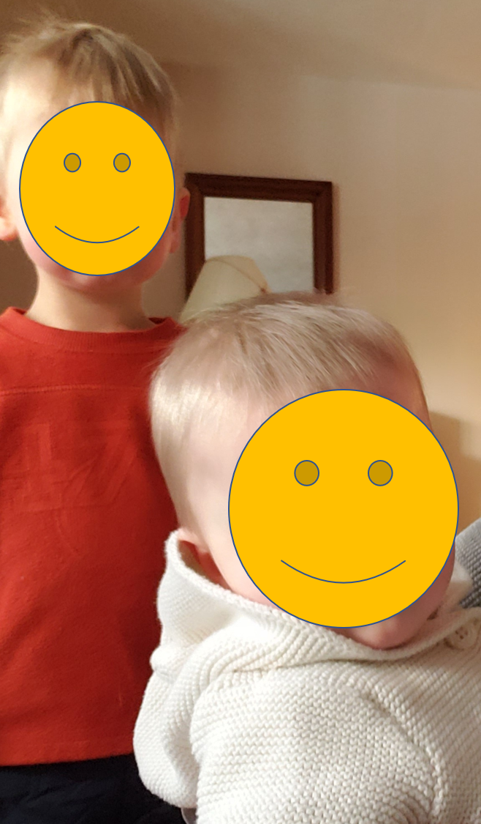
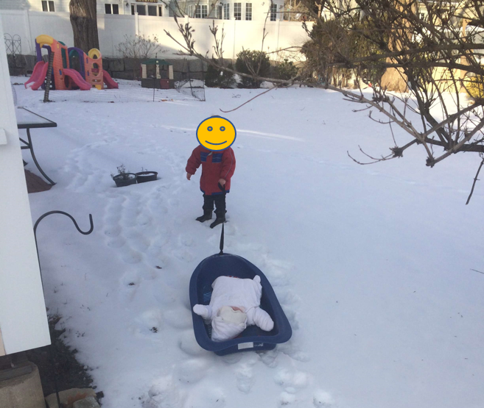
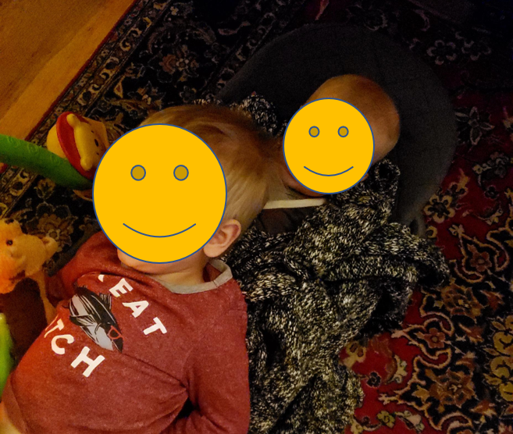
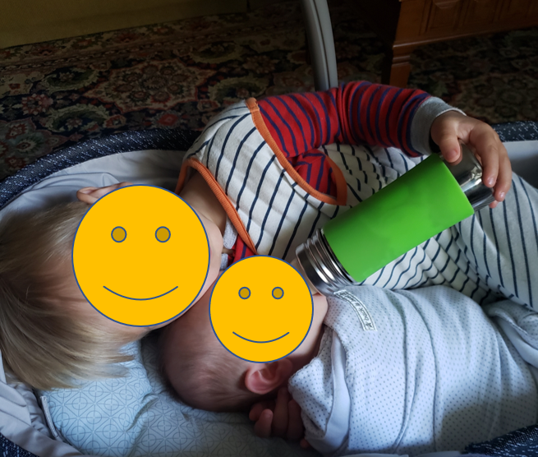
Notes:
And they’ve been pretty inseparable since. Hagop always wants to be doing what Zabel is doing, and loves teaching her things (like how to sled!)

Slide 8
What are some of your highlights from 2020?
Enter them into the chat, or feel free to shout them out!

Slide 9
Family resemblances…
Notes:
Before we move on to the main event… one fun thing… running through some family resemblances.

Slide 10
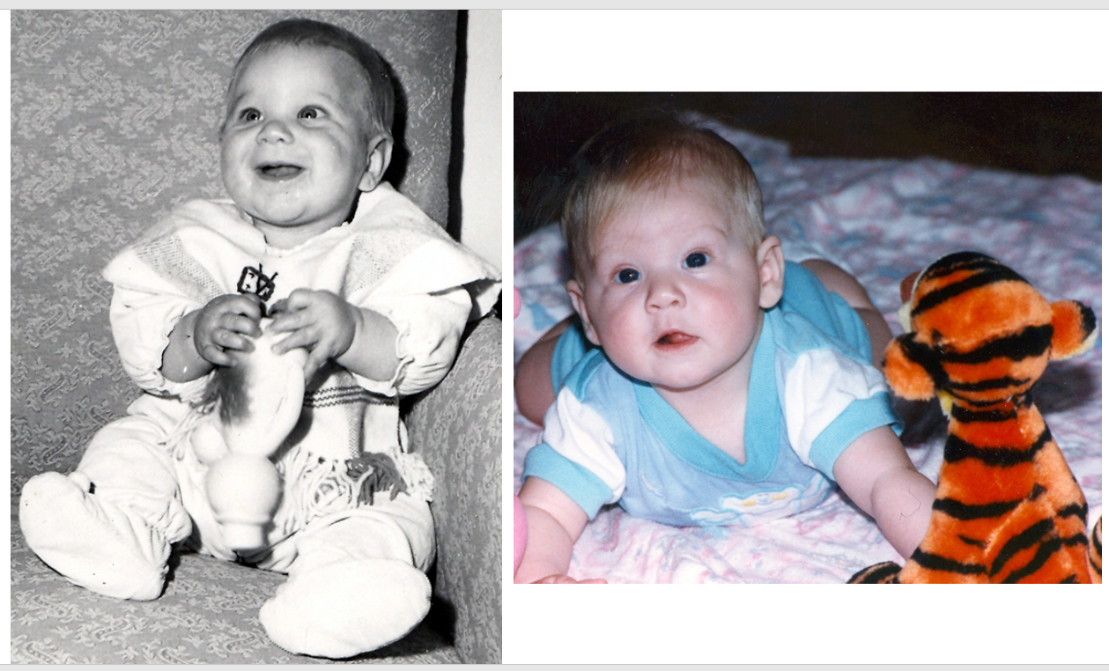
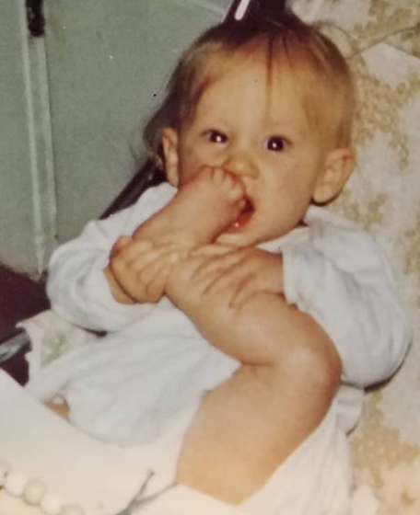
Grampa David, “Mom Mom” Kirsten, Mayrig Kalyn
Notes:
Here’s Kalyn’s side of the family.

Slide 11
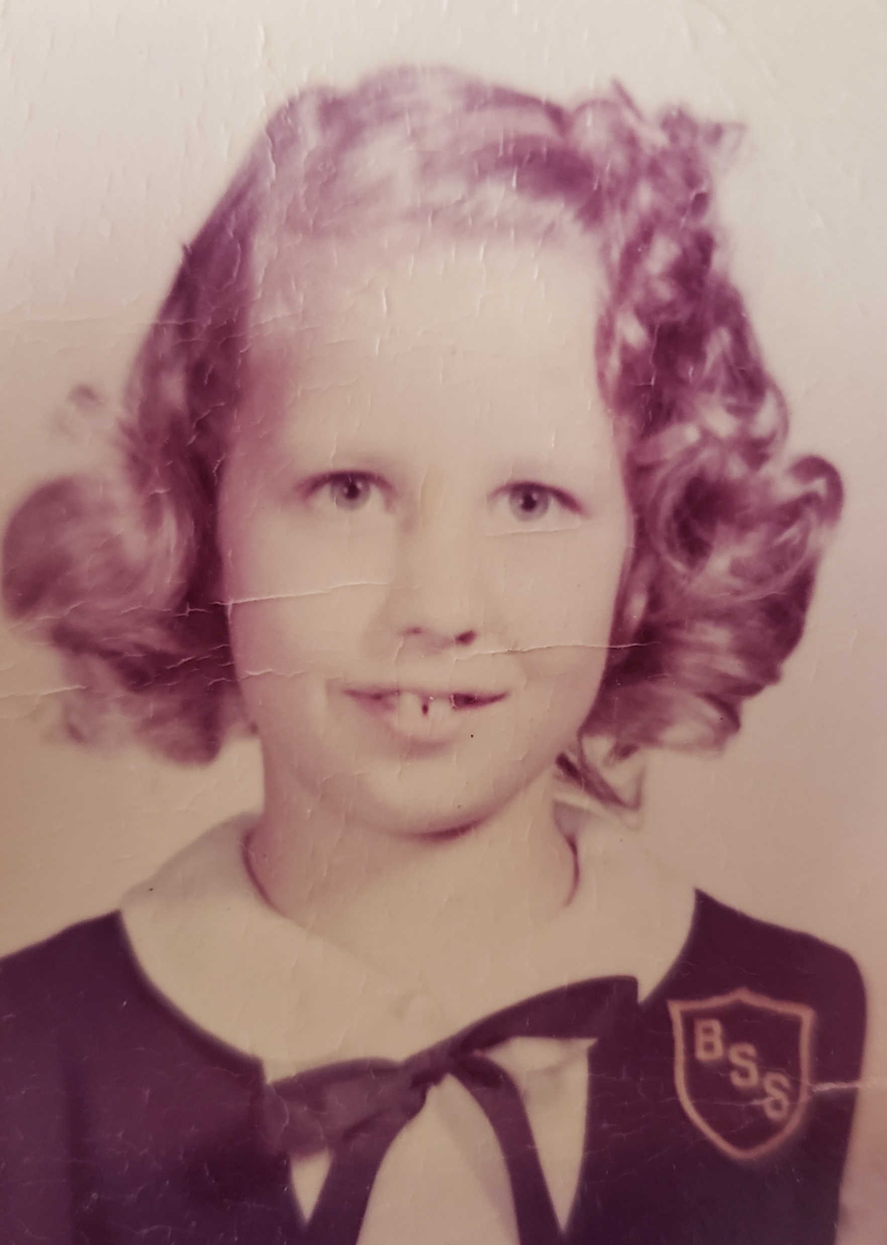
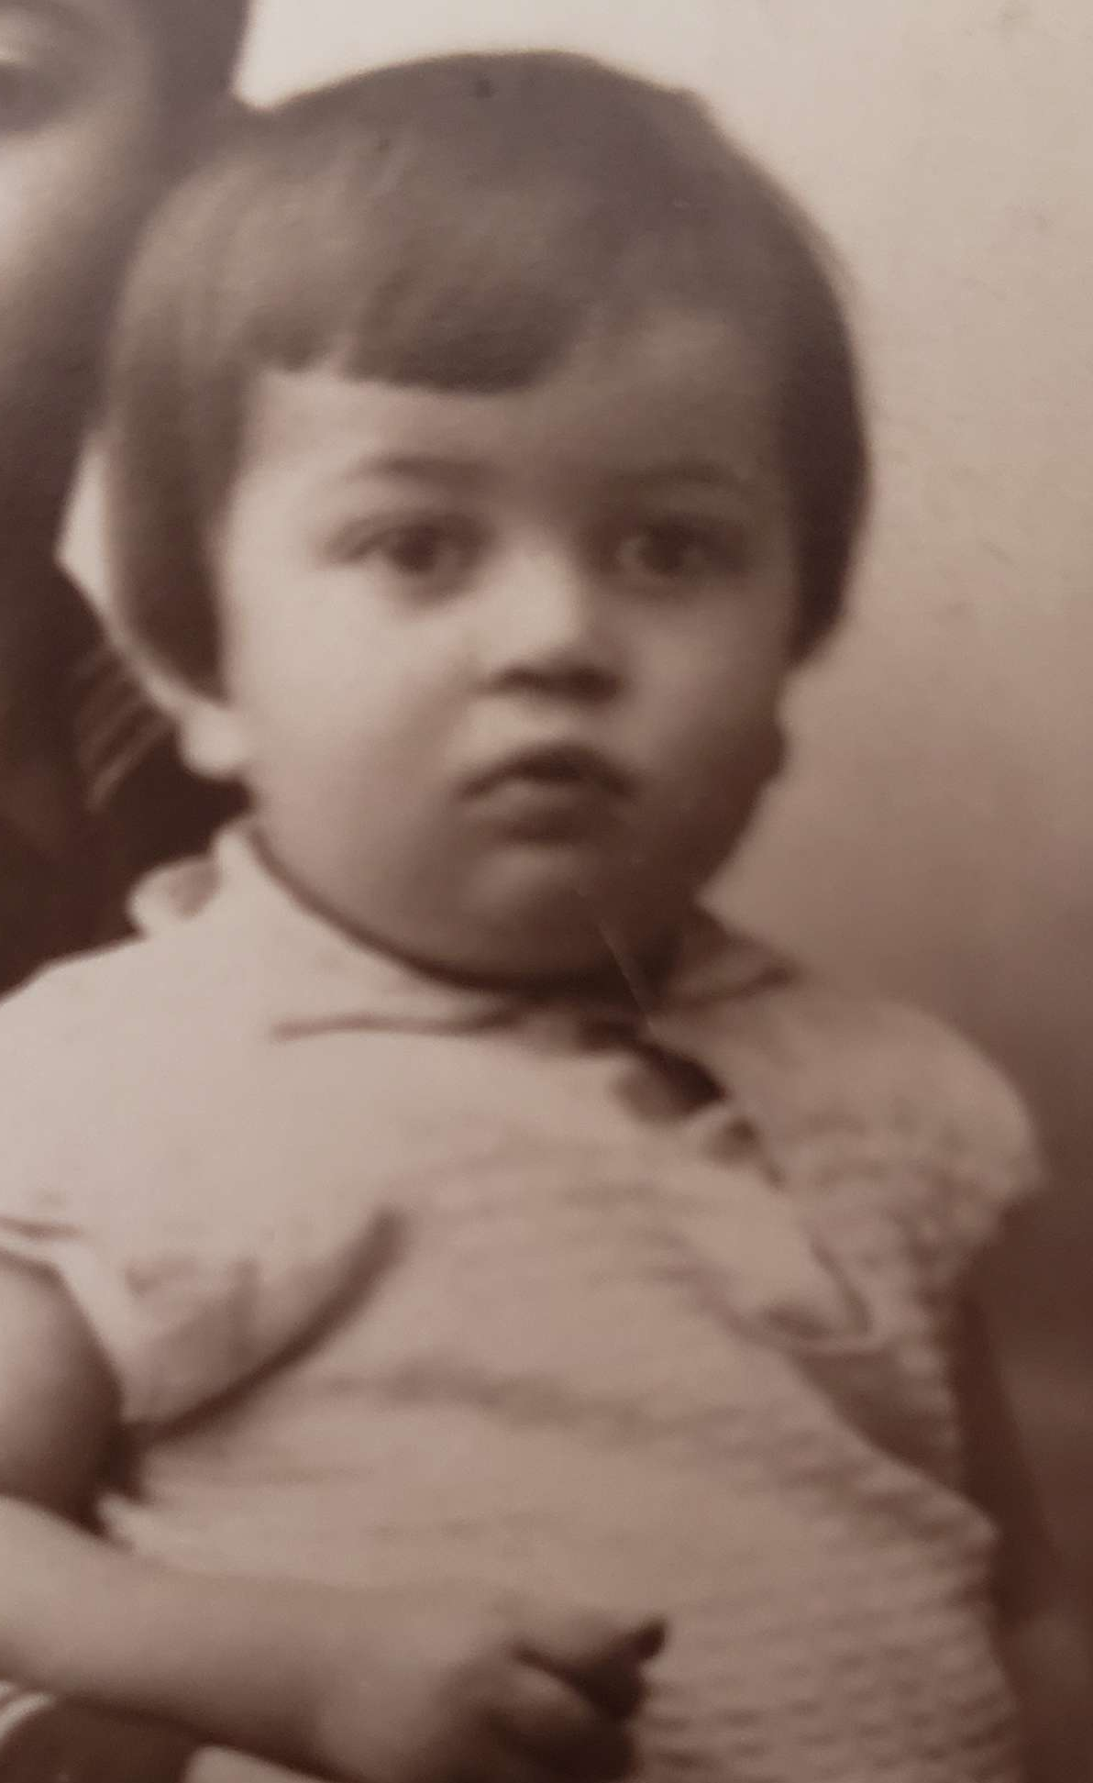
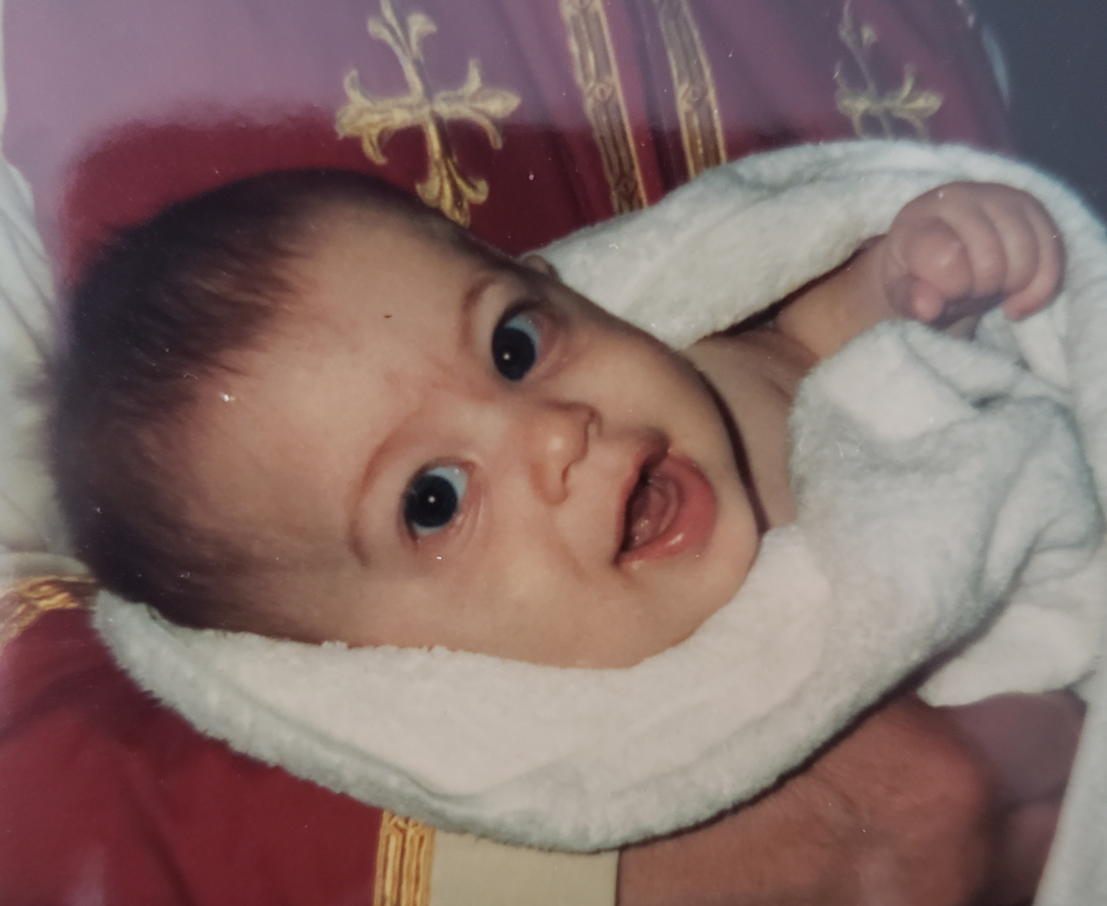
Medz Hayrig Hagop, Medzmama Carol, Hayrig Vartan
Notes:
And Vartan’s…

Slide 12
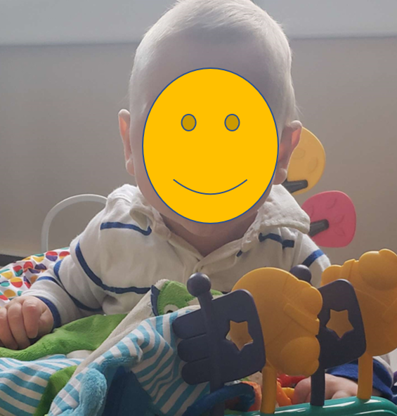
Vartan, Kalyn, and Hagopig…!
Notes:
Hagopig at 6 months looks a lot like baby Vartan! Do you think Zabel looks more like Kalyn’s side or Vartan’s?
(Stop sharing screen, show off baby.)

Slide 13
Will Zabel be a 4th generation engineer?
???
program officer
professor
finance ceo
engineer
engineer
priest
nurse
engineer
marketer
biologist
grocer
grocer
engineer
secretary
Notes:
And the real question here… is which side will Zabel take after, later in her life?
(Hagop isn’t destined to, we’re pretty sure he picked a syringe for “doctor.”)

Slide 14
Doctor?
Artist?
Musician?
Dentist?
Writer?
Teacher?
Mechanic?
Lawyer?
Chef?
Place your bets!
Notes:
Place your bets…!
(And then stop sharing screen, so we can watch Zabel “pick.”)
Zabel’s future career is only limited to the stuff we have around the house… hah!

Slide 15
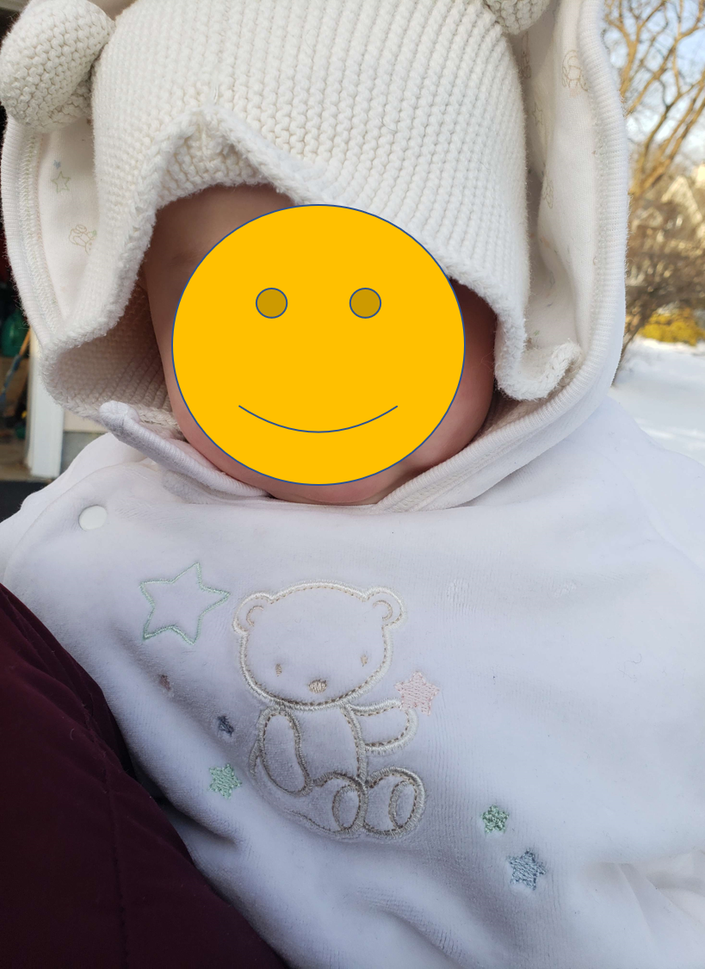
Toast to 2021, final words, and goodbye!

